Slide 1







managram
Shuffling “Magic: The Gathering” Cards
Into the Modern Economy
ETL Project by:
Elliazar Enriquez
Valarmathi Pukuraj

Slide 2
“Most Played Trading Card Game”
-Guiness World Records
“Magic: The Gathering” is officially the world’s most complex game
-MIT Technology Review
A strategy card game created by Dr. Richard Garfield, a mathematics professor and game designer, in 1993. Since it’s first core set, Alpha, Magic: The Gathering (MTG) now holds seven total world records and currently played in eleven languages globally with over 35 million players worldwide as of December 2018 according to Business Insider.
Catering to collectors and hobbyists, to start a game of Magic, a player would have a minimum of 60 cards per deck. The player can pick what goes into their deck from 70 expansion sets that contain up to 300+ cards each set. Buying and trading then happens until a deck composition is achieved either for casually playing with friends or competitively in tournaments.

Slide 3
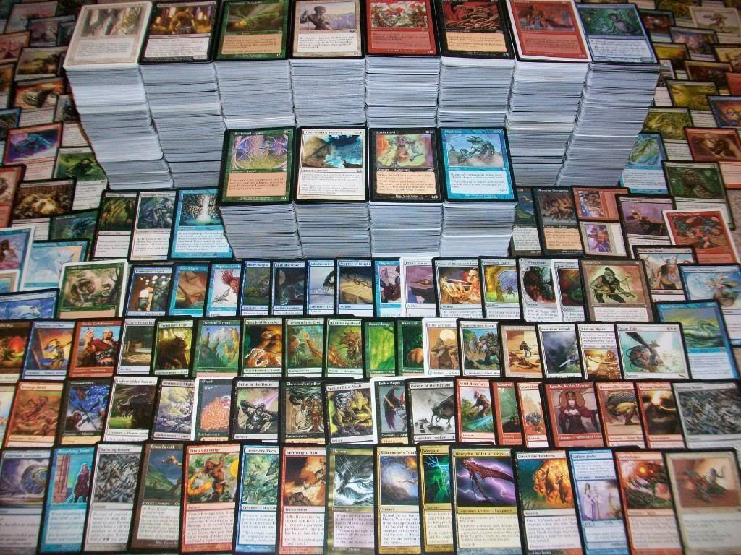
What makes a winner?
Each MTG card is rated by its unique factors such as age, edition, set of origin, mana cost, ability, printing rarity.
These are factors that Wizards of the Coast LLC, MTG’s official publisher weigh when setting the price tag for each card creating its market suggested retail price (MSRP)—this is the first market.
After cards are purchased directly from the publisher, cards then enter the secondary market where players sell, trade and buy to fulfill their deck compositions. Using the same factors that determined its MSRP, card prices in the secondary market can either inflate or drop.
Since it is dubbed as the most complex card game wherein no algorithm can determine a winner, the only limit will be your imagination, or BUDGET.

Slide 4
ETL!!!!
managram
Data
Gathered every card ever printed in the history of magic and created a core_card_objects table with unique oracle_id for each card.
This oracle_id served as a foreign key for the set description table that contained set specific descriptors for a specific card printed in that set.
Created a separate prices table that will contain various price listings obtained via API calls for each unique card identified via productid. Prices needs to be in a separate dynamic table due to fluctuations in prices on a daily basis to minimize altering the static tables such as core card and set description tables.
Challenges
Deleting duplicate entries to maintain a unique oracle_id, and productid while matching productid with a specific oracle_id to obtain prices via API calls.
API calls for 40000+ rows took the most amount of time, approx 30mins.
Future Considerations
To consistently rely on the most up to date price listing, we can create a flask app that runs the API call script on a specific schedule and load to database to update prices table.

